Slide 1
Web applications architecture
Andrii Palchik
November 2021

Slide 2
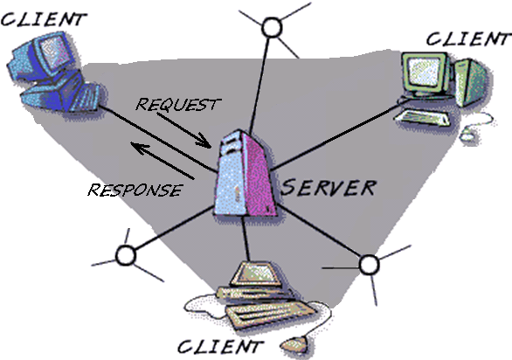
Web Applications Architecture
What is a server?
machine that provides services or responds to the requests made by the clients.
those are powerful computers or processes dedicated to managing disk drives (file servers), printers (print servers), or network traffic (network servers)
What is a client?
machine that makes the requests for desired services.
they may be defined as PCs or workstations on which users run applications.
Текст слайда

Slide 3

Hypertext Transfer Protocol
The Hypertext Transfer Protocol (HTTP) is an application protocol for distributed, collaborative, hypermedia information systems.
Hypertext is structured text that uses logical links (hyperlinks) between nodes containing text. HTTP is the protocol to exchange or transfer hypertext.
HTTP functions as a request-response protocol in the client-server computing model. A web browser may be the client and an application running on a computer hosting a web site may be the server.
The client submits an HTTP request message to the server.
The server, which provides resources such as HTML files and other content, or performs other functions on behalf of the client, returns a response message to the client.

Slide 4
Hypertext Transport Protocol (HTTP) characteristics
Request-response mechanism:
Transaction is initiated by a client sending a request to server
Server generates a response
Resource Identification
Each HTTP request includes a URI (Uniform Resource Identifier)
Statelessness
The server does not maintain any information about the transaction
Meta data support
Metadata about information can be exchanged in the messages

Slide 5
HTTP Request Format
Specifies request method
Request Line
GET /index.html HTTP/1.0
Specifies resource via URI
& meta data
Header Lines
Host: www.content-networking.com
Date: BBBBBBBBBBBB
User-Agent: Mozilla/5.0 (en) (WINNT; U)
Accept-Language: en-us
Carriage Return/Line Feed
Message Body
Content-length:
(Message Payload)

Slide 6
Request Methods
GET
Whatever information is identified by the Request-URI
Can Get static content and data produced by a program
POST
Submit information to Web Server
Eg: posting to blog, submission of user form…
Information is included in message body
The actual function depends on request URI
Example
POST/phonebook.cgi.HTTP/1.0
Date:
User-Agent:
Accept Language: en-us
Content Length: 14
98490 55266

Slide 7
Request Methods
HEAD
Servers response does not include message body
Useful for getting resource metadata without transferring the resource
Also useful for debugging , checking for validity, accessibility and modification
PUT
Requests a server store the enclosed data under the supplied Request URL.
Creates the resource if it does not create
Not useful for web publishing (FTP is preferred for security purposes)
DELETE
Removes the Web object
Needs to be carefully used for security reasons

Slide 8
HTTP Response Format
Status line with result code and phrase
Status line
HTTP/1.0 200 OK
Specifies server & resource meta data
Header Lines
Date: BBBBBBBBBBBB
Server: Apache/1.3.12 (Unix)
Last-Modified: (date)
Content Type: text/html
Carriage Return/Line Feed
Message Body
Content-length:
(Message Payload)

Slide 9
Result Code and Phrase
1xx: Informational – Not Done Yet
2xx: Success – You win
3xx: Redirection-You lose but try again
4xx: Client Error – You lose, your fault
5xx: Server Error – You lose, my bad
200 OK
204 No Content
300 Mutiple Choices
301 Moved Permanently
302 Moved Temporarily
304 Not Modified
400 Bad Request
401 Unauthorized
404 Not Found
500 Internal Server Error

Slide 10
Cookies
HTTP is stateless protocol
Cookies manage state maintenance by shifting the burden to client
Cookies are transmitted in clear text (security issue)
Client
Server
Usual HTTP Request
1st client request
Usual HTTP Response, including header line Set-cookie: <cookie>
Client does not interpret the cookie string
Server is presented with the previously returned state information
Usual HTTP Request, including header line Set-cookie: <cookie>
2nd client request
Usual HTTP Response

Slide 11
Web-Server
Web Server can mean one of two things:
A computer program that is responsible for accepting HTTP requests from clients, and serving them HTTP responses along with optional data contents, which usually are web pages such as HTML documents and linked objects.
A computer that runs a computer program as described above.

Slide 12
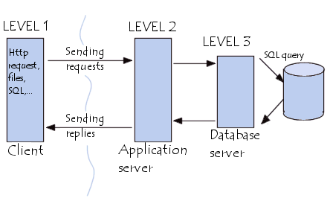
Web applications architecture
Level 1: Client → Web Browser
Level 2: Web server
Level 3: Database server

Slide 13
Backend and Frontend
In software engineering, the terms "front end" and "back end" are distinctions which refer to the separation of concerns between a presentation layer and a data access layer respectively.
Front end development is the development of those elements of a website that the customer sees and interacts with directly. It is a combination of programming skills (knowing which program to choose) and aesthetics (understanding element arrangements on the screen, the color and font choices).

Slide 14
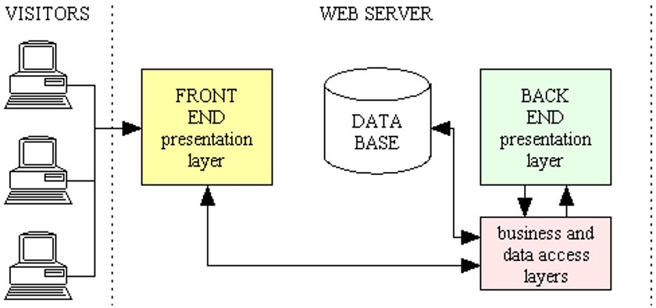
The Scheme

Slide 15
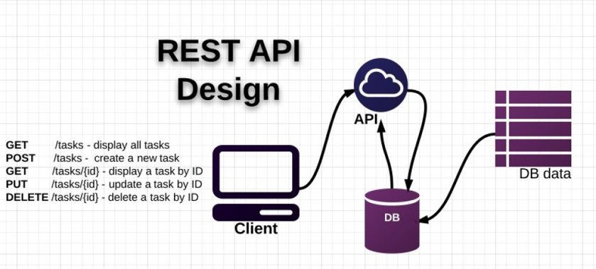
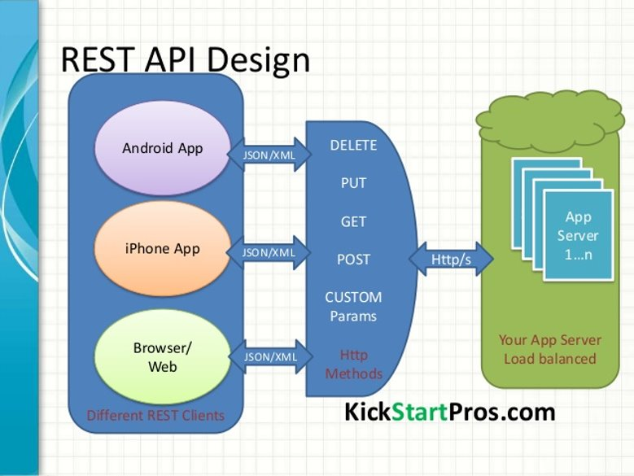
REST
In computing, Representational State Transfer (REST) is the software architectural style of the World Wide Web

Slide 16


